Slide 1
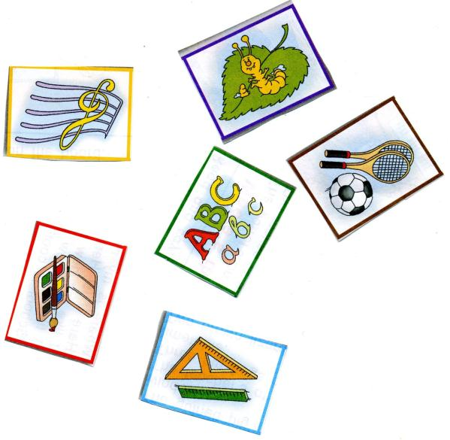


School
subjects
1
2
4
Art
Music
English
Mathematics
Literature
Physical Education
Biology
3
7
5
6

Slide 2
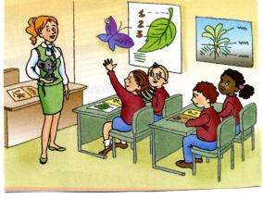
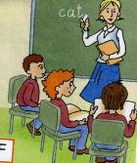
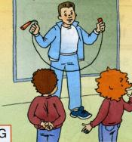
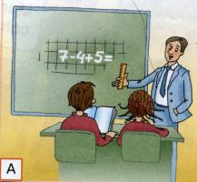
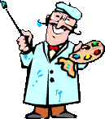
Find the teacher
Miss London is an…
Miss Rose is a….
Mr. Seven is a …
Mr Run is a…
Mr Green is an…

Slide 3



I like… I don`t like…
It is easy.
It is difficult
It teaches me …
To think
To speak
To read

Slide 4
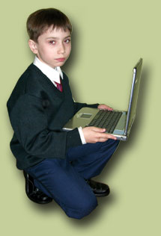
Let`s count the lessons
My first lesson is Computing.
What is your first lesson?

Slide 5
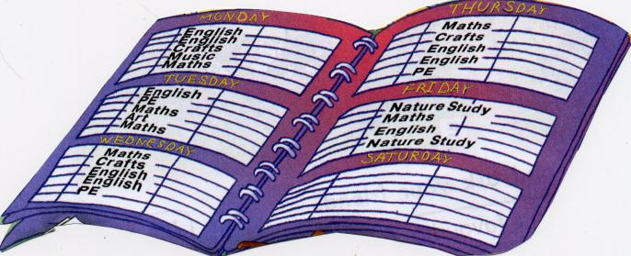
Every week
Every week has seven days
See how many you can say.
Sunday, Monday, Tuesday, Wednesday,
Thursday, Friday, Saturday.
Tell me please, what day is it today?

